Slide 1
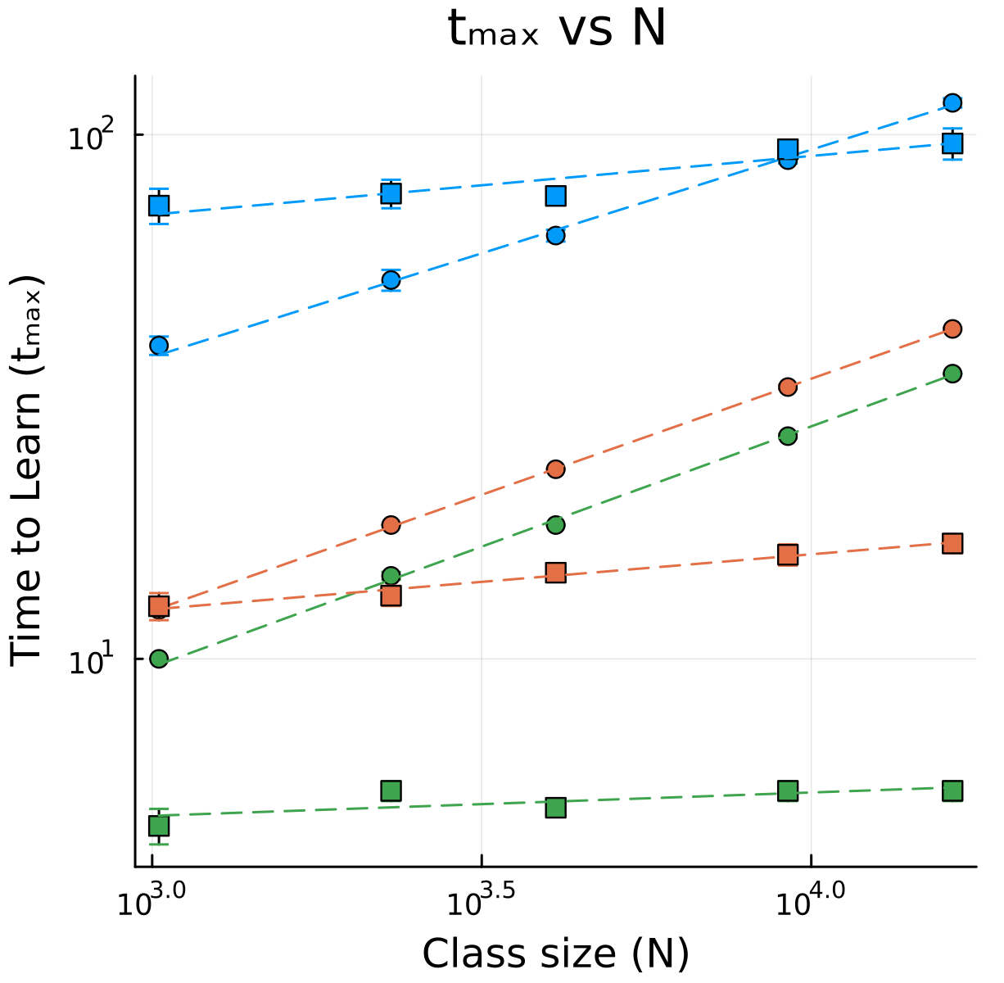
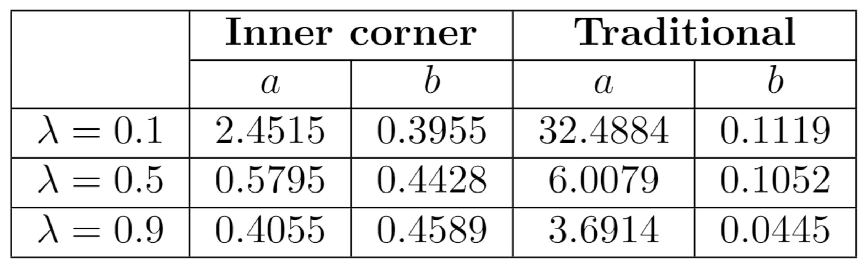
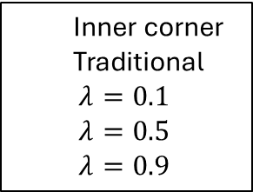
T(0.1)
Inner corner
Traditional
$λ=0.1$
$λ=0.5$
$λ=0.9$
I(0.1)
I(0.5)
I(0.9)
T(0.5)
T(0.9)

Slide 2
Inner corner
Center
Outer corner

Slide 3
Inner corner
Center
Outer corner
Random

